Slide 1
MCDB 187AL Midterm
Tanveer Salim

Slide 2
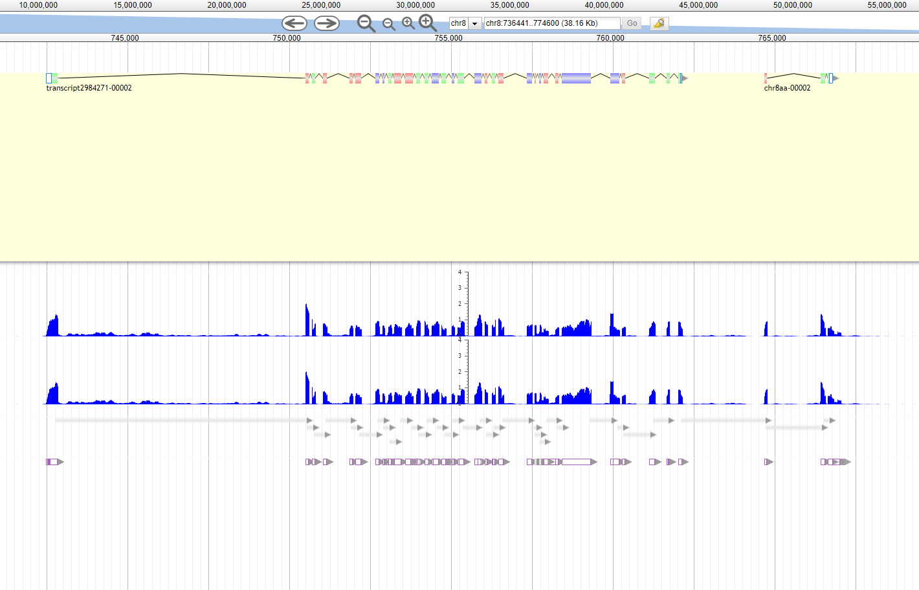
Gene Construct at Chr8 742500

Slide 3
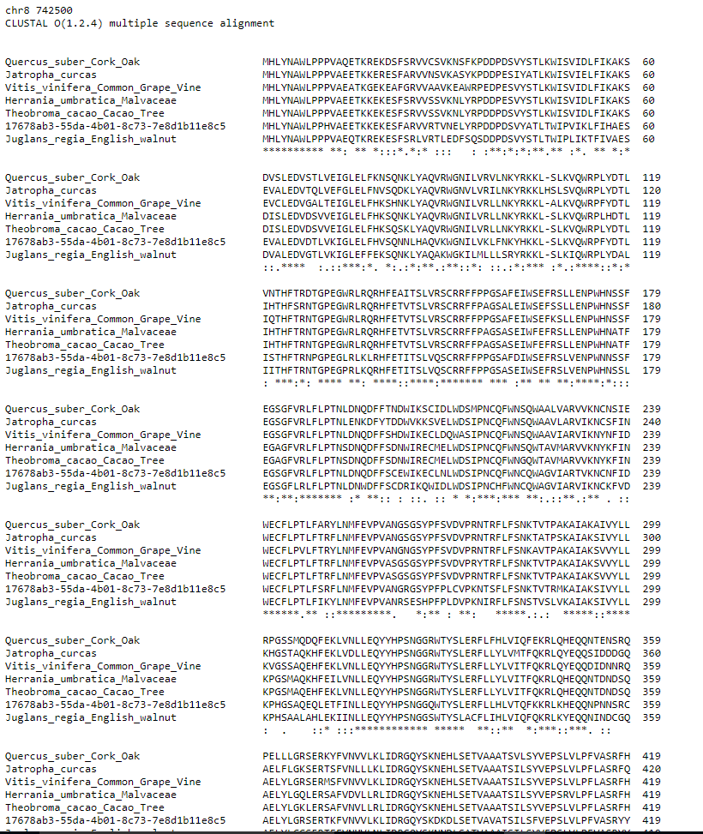
Multiple Sequence Alignment

Slide 4
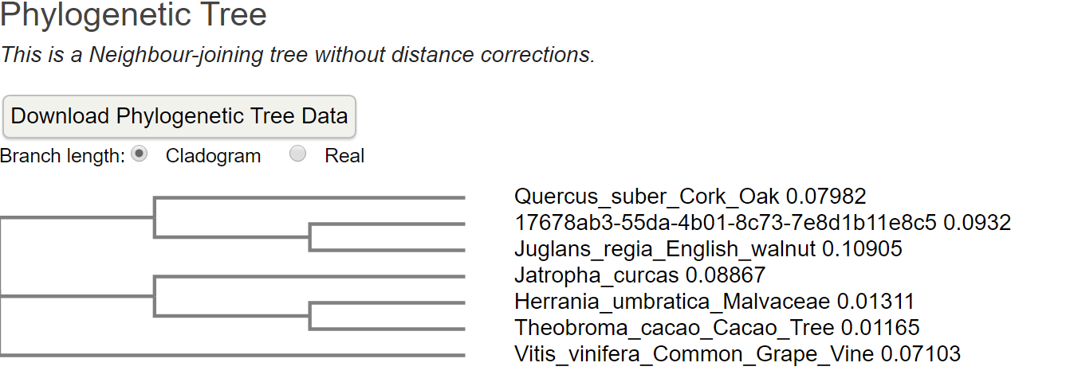
Phylogenetic Tree

Slide 5
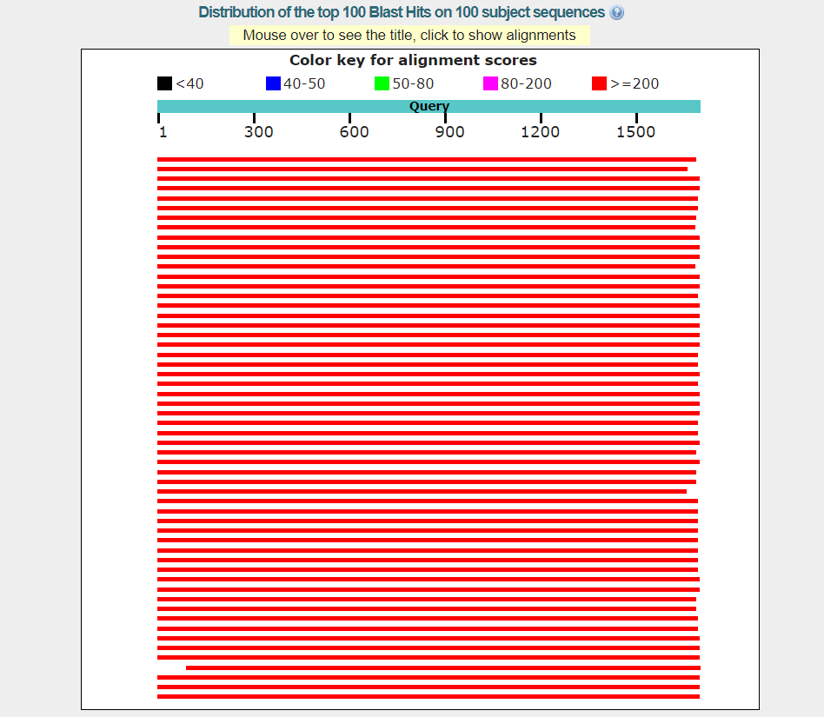
Color Key

Slide 6
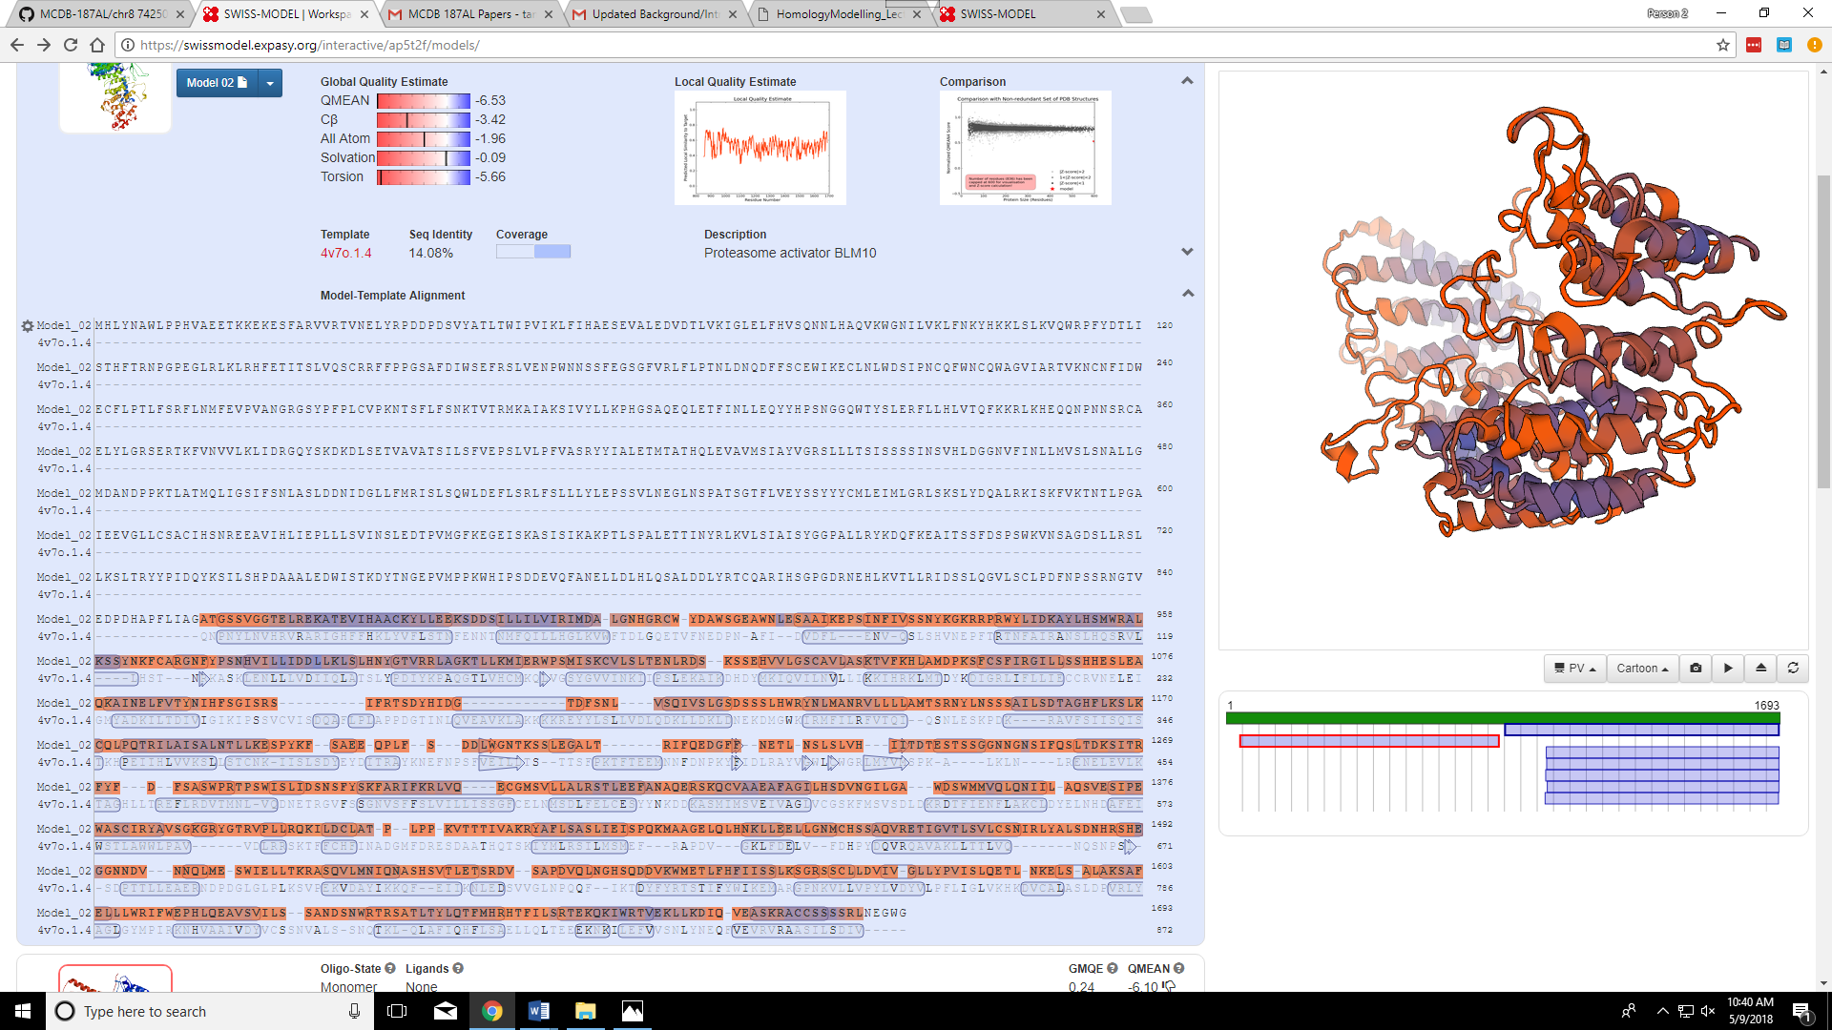
SWISS Results

Slide 7
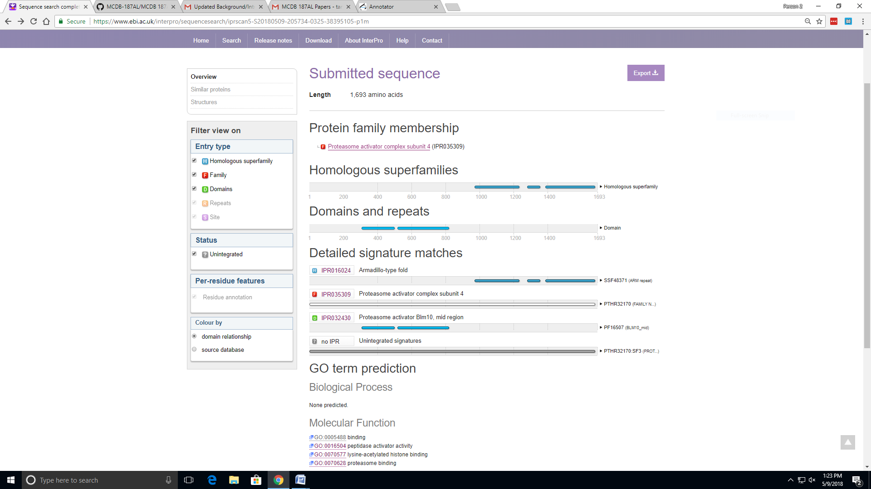
InterProScan Results

Slide 8
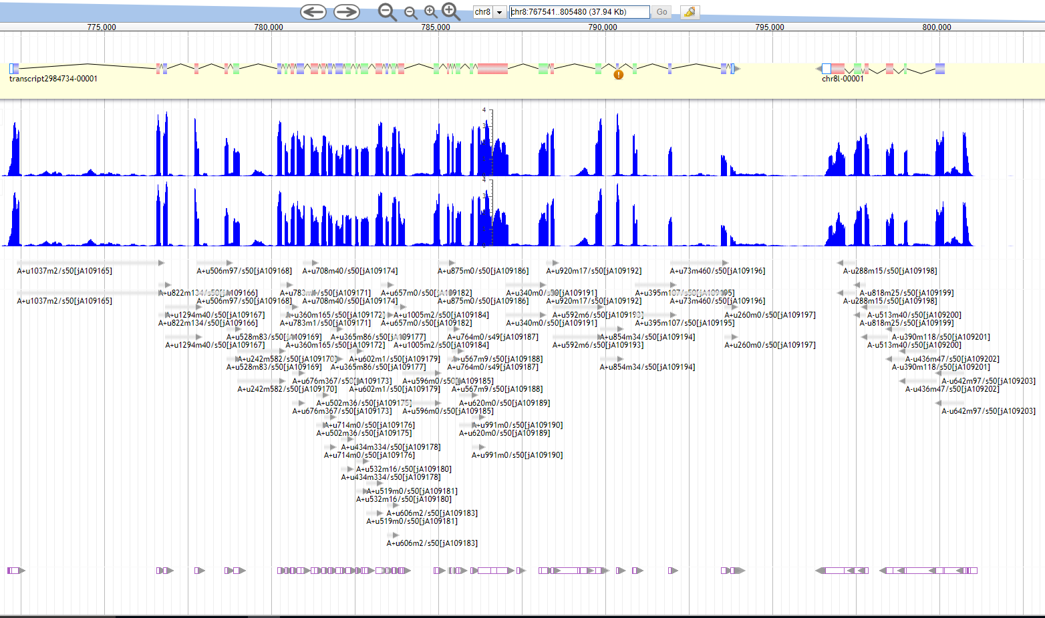
Chr8 772500

Slide 9
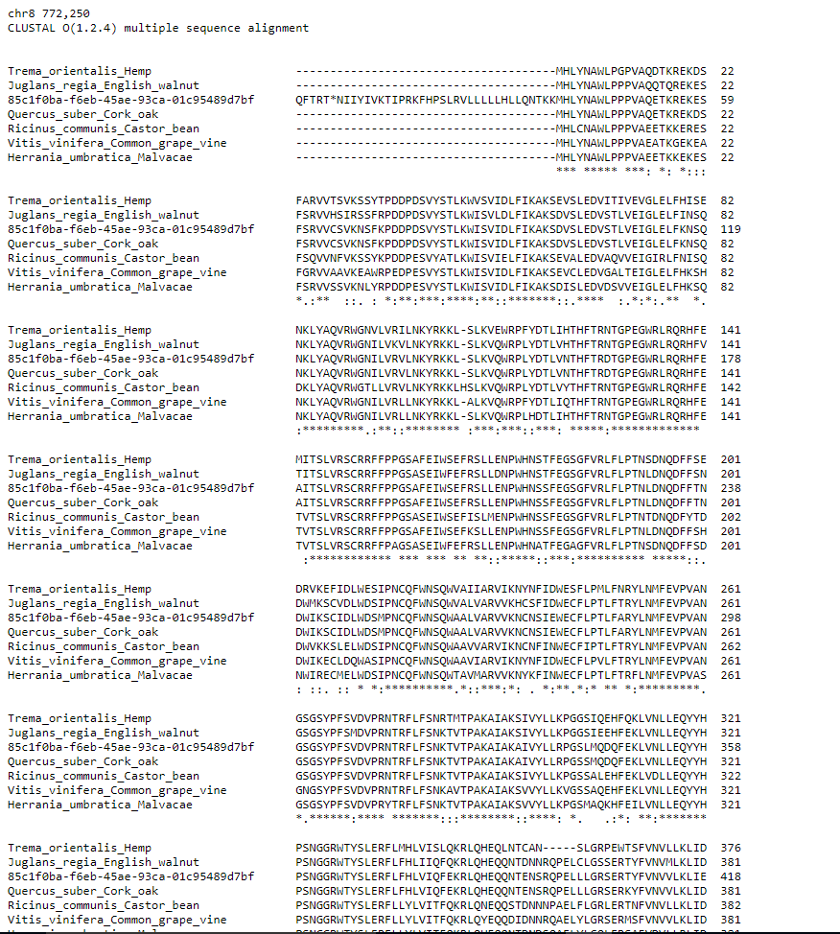
Multiple Sequence Alignment

Slide 10
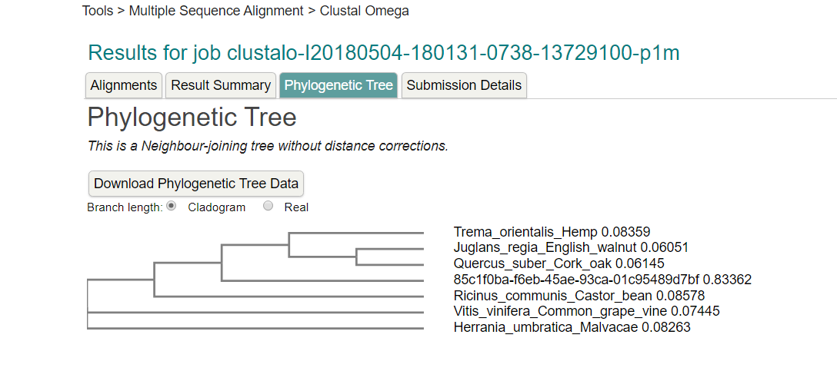
Phylogenetic Tree

Slide 11
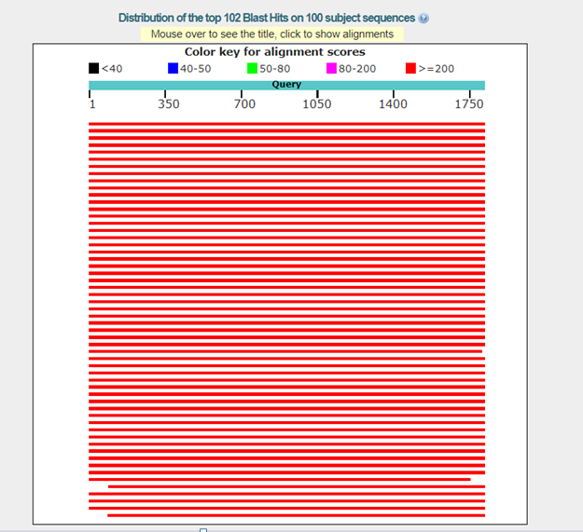
Color Key

Slide 12
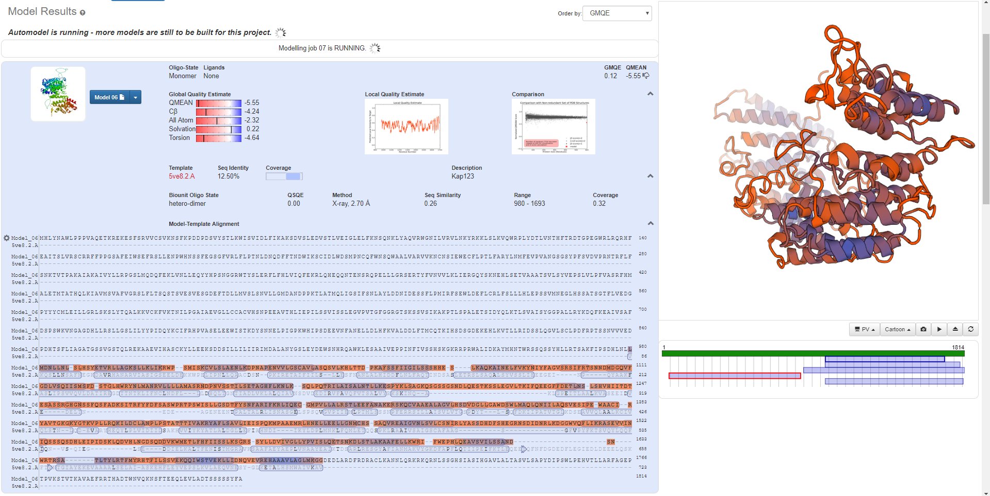
SWISS Model Results

Slide 13
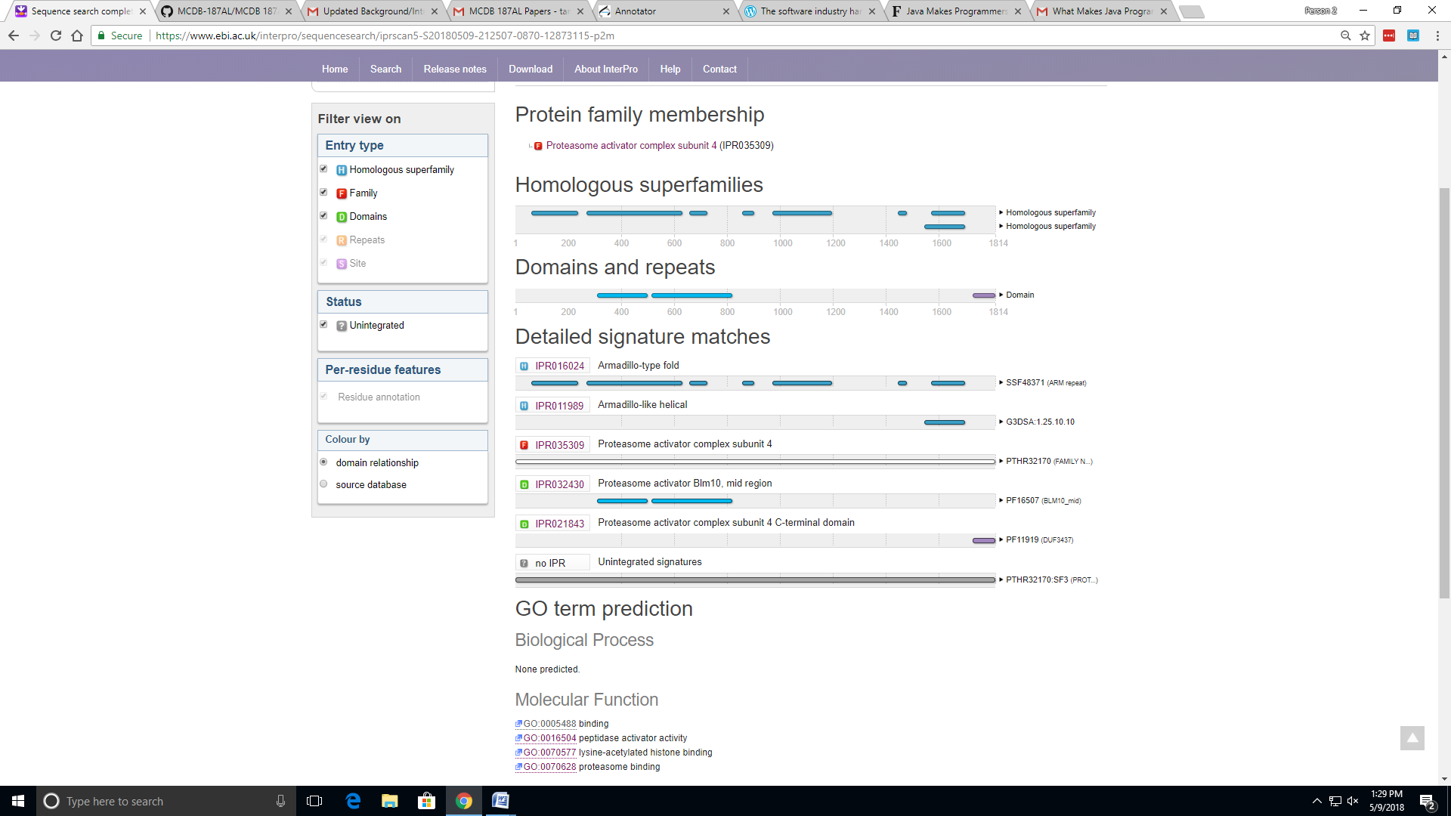
InterProScan Results

Slide 14
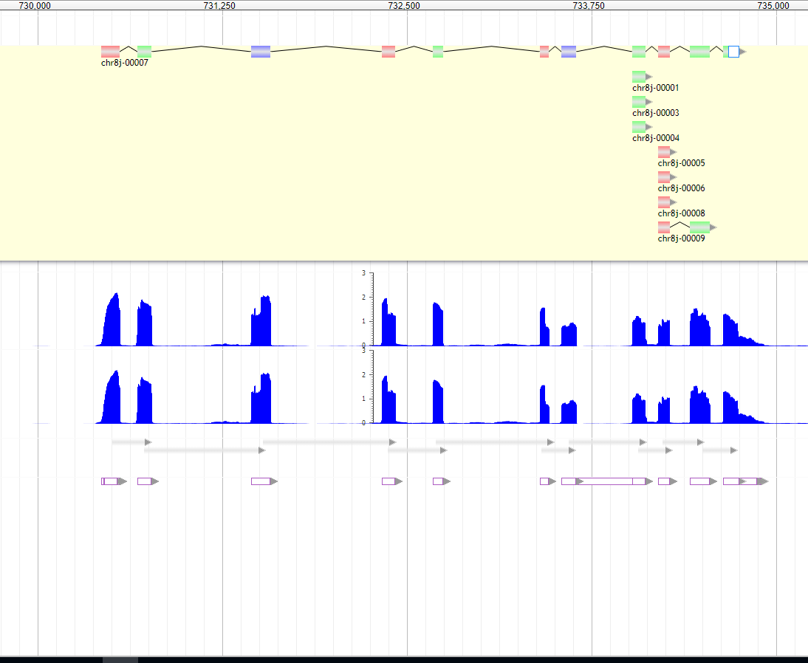
Chr8 730000

Slide 15
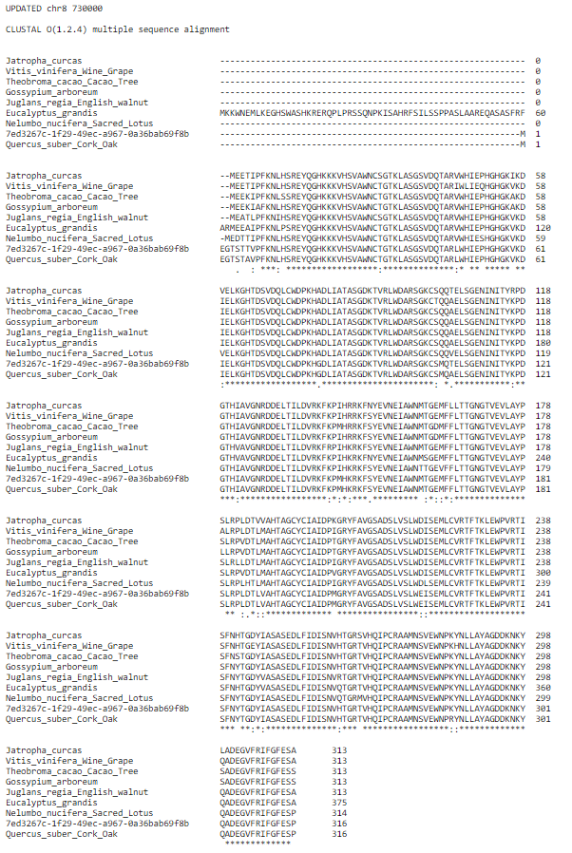
Multiple Sequence Alignment

Slide 16
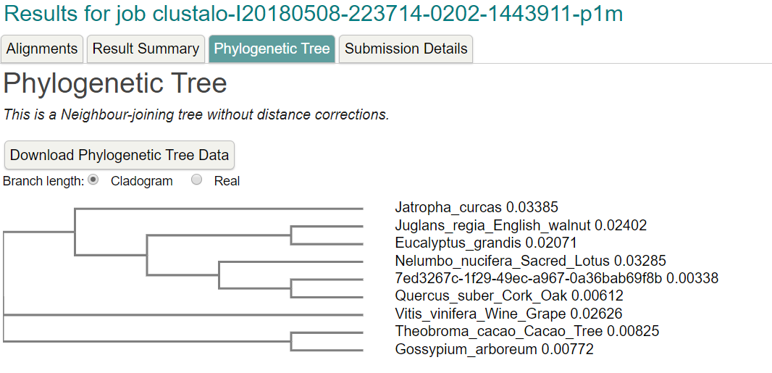
Phylogenetic Tree

Slide 17
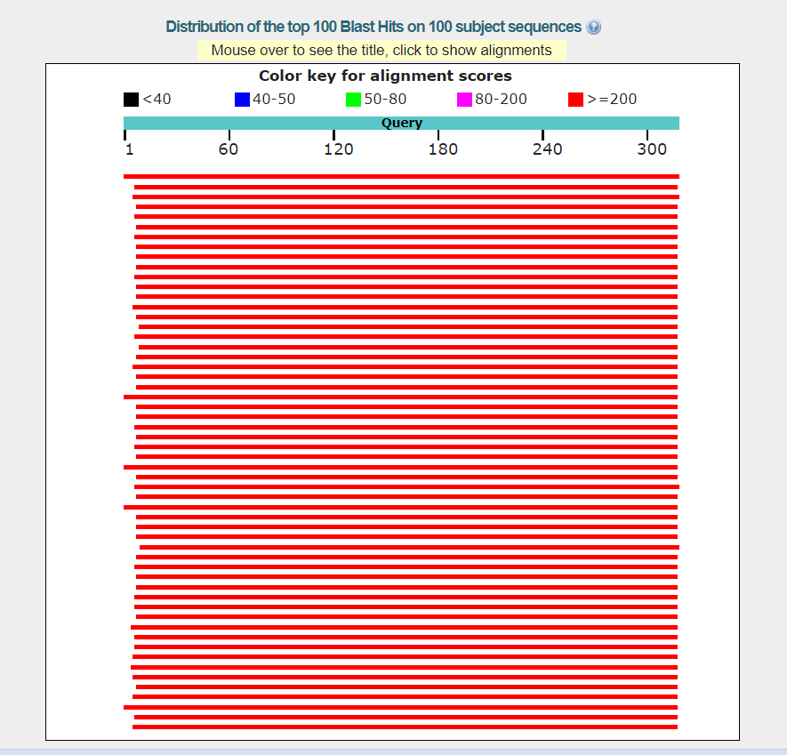
Color Key

Slide 18
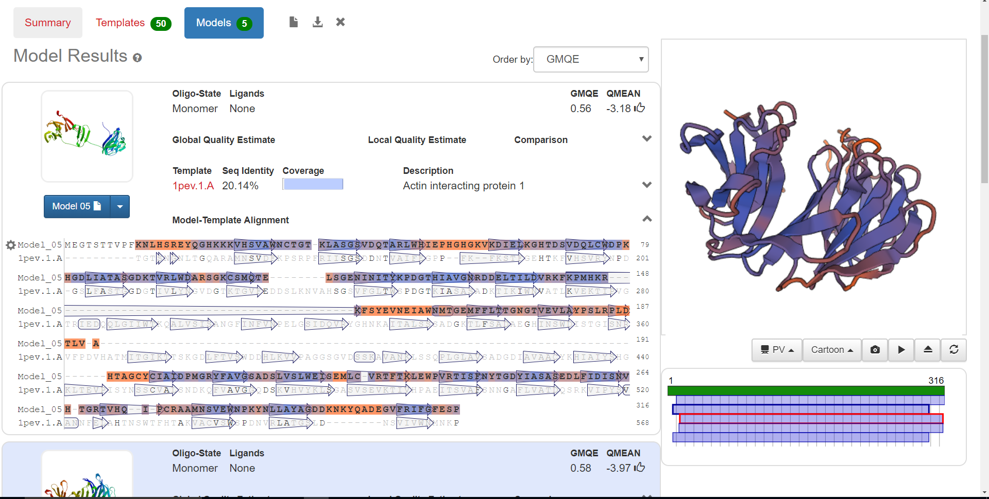
SWISS MODEL

Slide 19
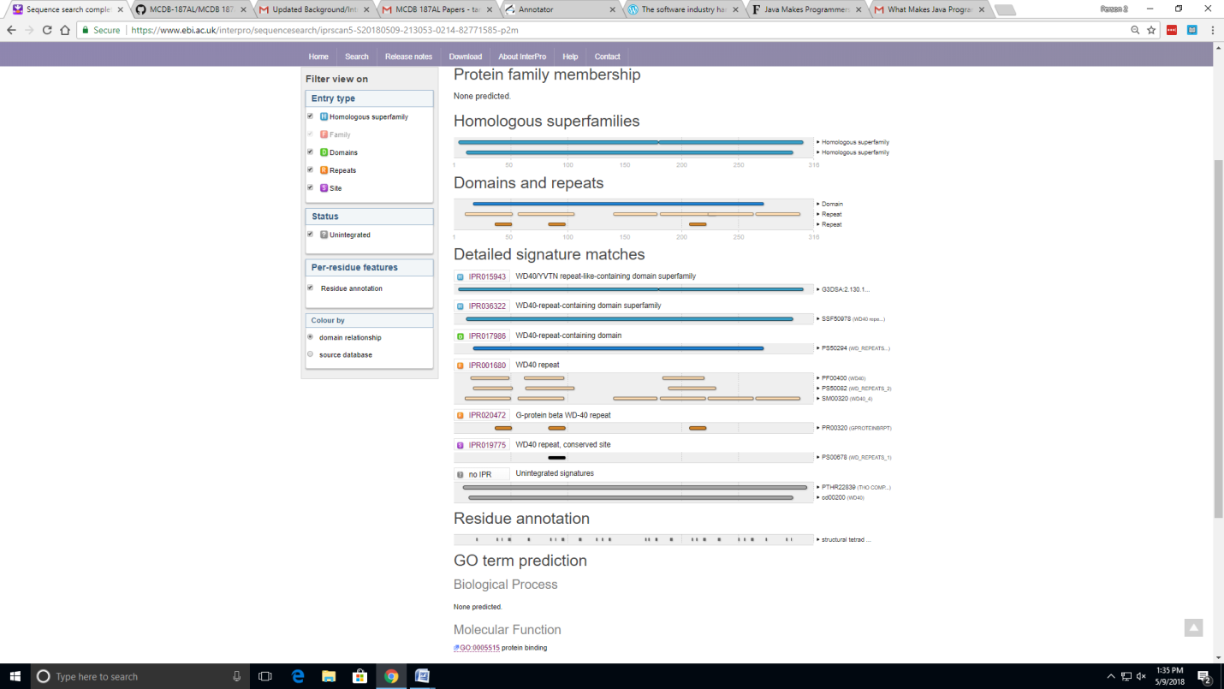
InterProScan

